Slide 1
Modelling of Dependence in Impulsive Interference and Copual Theory
Chris (Ce) ZHENG
IEMN-IRCICA, CNRS
University of Lille 1
Ce.zheng@etudiant.univ-lille1.fr

Slide 2
Modeling of Interference
SCMA
Copula Theory
Simulations

Slide 3
Modeling of Interference
Interference Model
I. Classic Gaussian Model:
Impulsiveness ---- low tail probability
Dependence --- i.i.d
II. Modeling of Impulsiveness
Alpha-stable Model --- long tail in PDF
III. Modeling of Dependence:
Sub-Gaussian Model
Copula Theory

Slide 4
Modeling of Interference
Two determinants of interference^{[1]}:
Path Law
Network Geometry, i.e. the distribution of ’Interferers’ (nodes concurrently transmitting singals).
(1) the distribution of interfering nodes
(2) the multiple access scheme. E.g. SCMA
[2] Weber, Steven, and Jeffrey G. Andrews. "Transmission capacity of wireless networks." Foundations and Trends® in Networking5.2–3 (2012): 109-281.

Slide 5
Modeling of Interference
Alpha-stable model:
Network Geometry --- PPP (Poisson Point Process)
Aggregate interference --- α-Stable^{[2]}.
Characterizes impulsivness
Captures the characteristics of network geometry
[2] ILOW, Jacek et HATZINAKOS, Dimitrios. Analytic alpha-stable noise modeling in a Poisson field of interferers or scatterers. IEEE transactions on signal processing, 1998, vol. 46, no 6, p. 1601-1611..

Slide 6
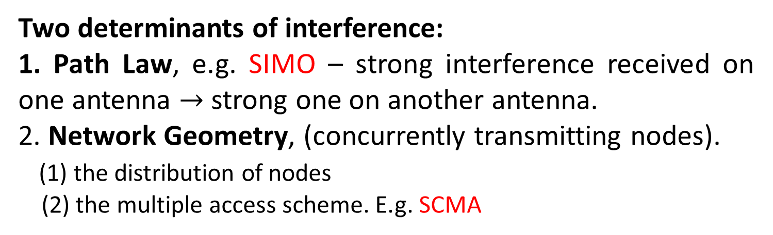
Modeling of Interference
Question : Why there is dependence of interference in wireless network?
Two determinants of interference:
1. Path Law, e.g. SIMO – strong interference received on one antenna $→$ strong one on another antenna.
2. Network Geometry, (concurrently transmitting nodes).
(1) the distribution of nodes
(2) the multiple access scheme. E.g. SCMA

Slide 7
Modeling of Interference
SCMA
Copula Theory
Simulations

Slide 8
SCMA
Model (PPP with ) :
1. Each device transmits over a subset of orthogonal bands
2. Each device j transmits the message W_{j} uniformly drawn from the set
3. Encoder maps each message to a SCMA codeword in
4. One SCMA codeword is composed of m non-zero elements selected from the set of all authorized subsets of

Slide 9
SCMA
Scenario --- General SCMA codebook
The non-zero elements of each codeword are assumed to be independently chosen for each device, i.e. each device selects the m bands uniformly from .
Interference is
(2-1)
---- rayleigh fading of device j on band k
---- distance to the access point
---- path-loss exponent
---- PPP with ,where

Slide 10
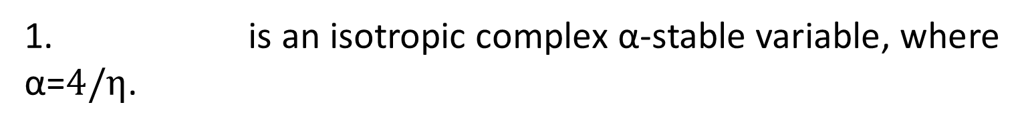
SCMA
Scenario --- General SCMA codebook
1. is an isotropic complex α-stable variable, where $\text{α}\text{=}4/η$.
(2-2)
is sub-Gaussian, where
---- skewed α-stable
, ---- independent Gaussian variables, i.e

Slide 11
SCMA
Scenario --- General SCMA codebook
2. Stacking real and imaginary parts, we have the 2k dimensional interference vector
(2-3)
is a symmetric α-stable vector.
Dependence structure remains unspecified.

Slide 12
SCMA
Scenario --- disjoint SCMA codebook
Devices choose m bands to transmit
Given K bands --- [K/m] disjoint subsets.
Devices transmits on one of these [K/m] disjoint subsets
The m dimensional interference vector is sub-Gaussian.

Slide 13
Modeling of Interference
SCMA
Copula Theory
Simulations

Slide 14
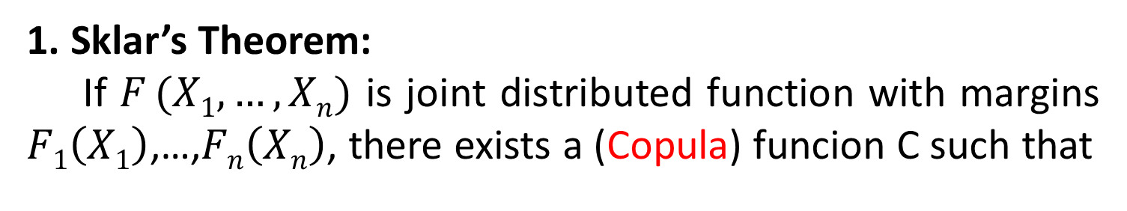
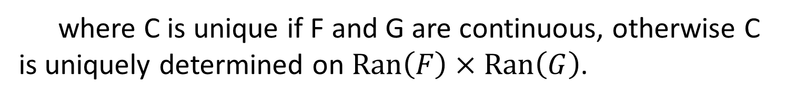
Copula Theory
Question : What is copula?
1. Sklar’s Theorem:
If $F (X1,…,Xn)$ is joint distributed function with margins $F1\left(X1\right)$,…,$Fn\left(Xn\right)$, there exists a (Copula) funcion C such that
(3-1)
where C is unique if F and G are continuous, otherwise C is uniquely determined on $Ran\left(F\right)×Ran\left(G\right)$.
(3-2)

Slide 15
Copula Theory
Question : What is copula?
2. PDF of $\vec{X}=(X1,…,Xn)$:
(3-3)
Dependent component
Independent component
(3-4)

Slide 16
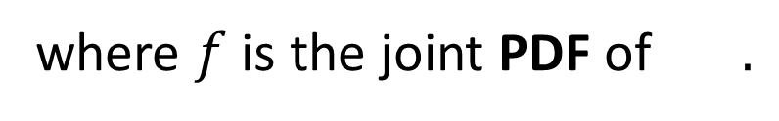
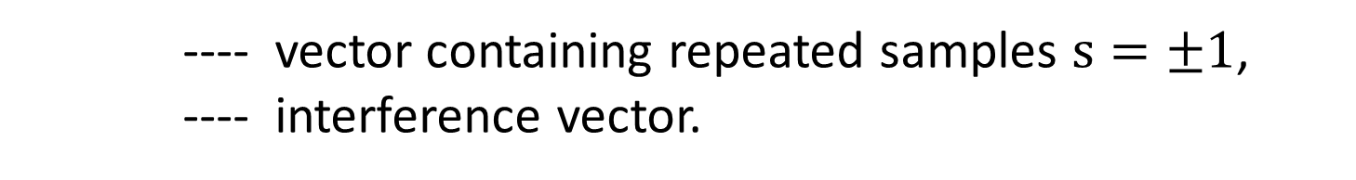
Copula Theory
Question : why copula?
3. Receiver:
In a BPSK system, the received signal is:
(3-5)
---- vector containing repeated samples $s=±1$,
---- interference vector.
Log likelihood ratio (LLR) will be:
(3-6)
where $f$is the joint PDF of $.$

Slide 17
Copula Theory
Question : Relation between copula and our research
3. Receiver:
Hence, the LLR becomes:
(3-7)
Dependent strcuture
Independent structure
tricky

Slide 18
Copula Theory
4. Elliptical copula:
(3-8)
F is elliptically distributed:
(3-9)
---- uniformly distributed on unit sphere
----
1. Gaussian
2. Student t , v ---- the degree of freedom
3. Sub-Gaussian , A ---- skewed α-stable

Slide 19
Modeling of Interference
SCMA
Copula Theory
Simulations

Slide 20
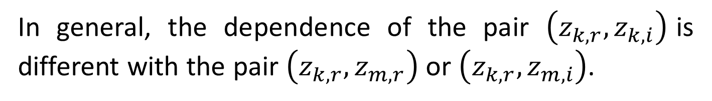
Simulation
Interference vector:
(4-1)
Joint distribution of :
(4-2)
In general, the dependence of the pair $\left(z_{k,r},z_{k,i}\right)$is different with the pair $\left(z_{k,r},z_{m,r}\right)$ or $\left(z_{k,r},z_{m,i}\right)$.

Slide 21
Simulation
1. Dependence between Real and Imaginary parts:
Figure 1. Joint distribution of G₁ and G₂
1. Isotropic
2. Uniformly distributed

Slide 22
Simulation
1. Dependence between Real and Imaginary parts:
Figure 2. Real and Imaginary Parts of Interference
1. Isotropic
2. Conditionally Gaussian
3. Strong dependence in impulsiveness

Slide 23
Simulation
1. Dependence between Real and Imaginary parts:
Factors that may have impact on our observation for dependence are (1) the number of samples and (2) the scale of axes in our simulation.
We can also prove that α-stable sub-Gaussian belongs to the familly of elliptical distribution^{[3]}.
[2] Kring, Sebastian, et al. "Estimation of α-stable sub-Gaussian distributions for asset returns." Risk Assessment. Physica-Verlag HD, 2009. 111-152.

Slide 24
Simulation
2. Dependence between Real parts:
Figure 3. Real Parts of Interference on different bands
from Malcolm’s code

Slide 25
Simulation
3. Density of its margins(CDF):
There is a dependence.
Look at the density of its margins (CDF).
Figure 4. Density of margins of α-stable interference

Slide 26
Simulation
3. Density of its margins(CDF):
Figure 4. Density of margins of α-stable interference
Figure 5. Density of t copula function
T copulas with different Degree of Freedoms have similar densities.

Slide 27
Simulation
4. T copula Function:
Figure 4. t copula and interference samples (v=10)

Slide 28
Simulation
Figure 5. t copula and interference samples (v=1)

Slide 29
THANK YOU！

